Slide 1
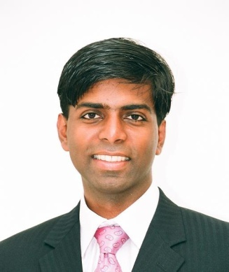
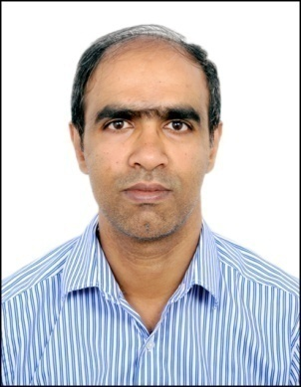
NATIONAL CENTRE FOR COMBUSTION RESEARCH & DEVELOPMENT
Guest Lecture
Date : Thu, 21st Jan 2016, Time : 2.30PM, Venue : MSB211
Brief bio of Renith : For the past 9 years, Dr. Renith Richardson worked primarily on spray & combustion related technologies. He has pioneered the use of auto/adaptive mesh in industry to reduce design cycle time. He has developed strategic roadmap and championed it for internal combustion engine CFD. Also, as a project leader for Advanced Design Tools has managed large teams and developed physics based tools. He received his Ph.D from Purdue University (Dept of Aero & Astronautics) for his thesis “Linear& non-linear dynamics of swirl injectors ". This involved both analytical and CFD based simulations validated with experiments. Currently, Renith leads the GT simulations group at Siemens corporate research.
Brief bio of Vinay: Vinay Ramanath has over 14 years of experience in the area of advanced nonlinear multidisciplinary optimization, uncertainty quantification, robust design, design for six sigma, Bayesian approaches for model calibration, advanced visualization and surrogate modeling technologies. Vinay has extensively applied these advanced techniques across gas turbine components and systems for aircraft engines and power generation services. Vinay is a certified Black Belt for Design for Six Sigma and Reliability and is currently working in Siemens corporate research and technology as a Senior Key Expert for Probabilistics.
Title: Driving Digitalization at Siemens
Abstract: Siemens is 170 year company with it primary focus on innovation. Based on the prevalent megatrends in the coming decades Siemens is positioned to grow in the areas of digitization, automation and electrification. A key component of digitalization is simulations. Here we’ll share simulation examples on combustion, acoustics and robust design and how they map to the overall vision of Siemens. ALL ARE WELCOME

